Slide 1
24MAT120
S2 P&M

Slide 2
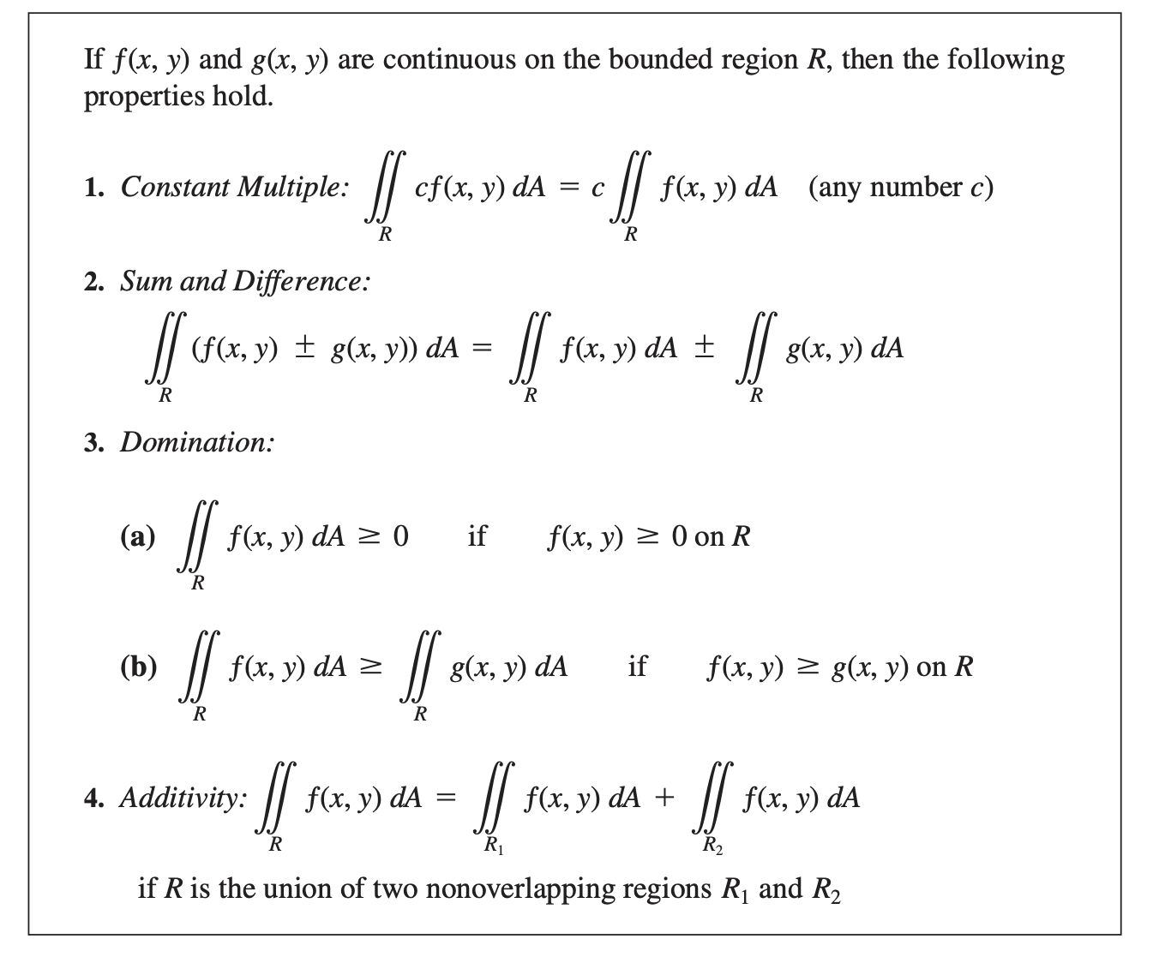

Slide 3


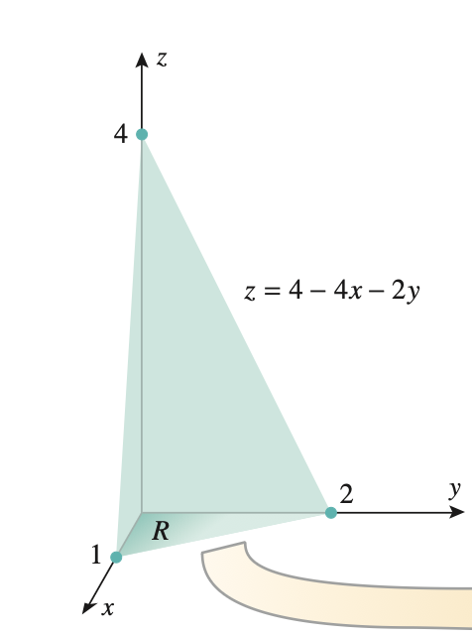
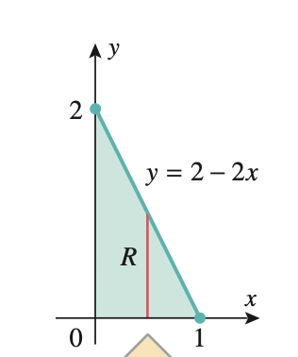
Use a double integral to find the volume of the tetrahedron bounded by the coordinate planes and the plane
z = 4− 4x− 2y.

Slide 4
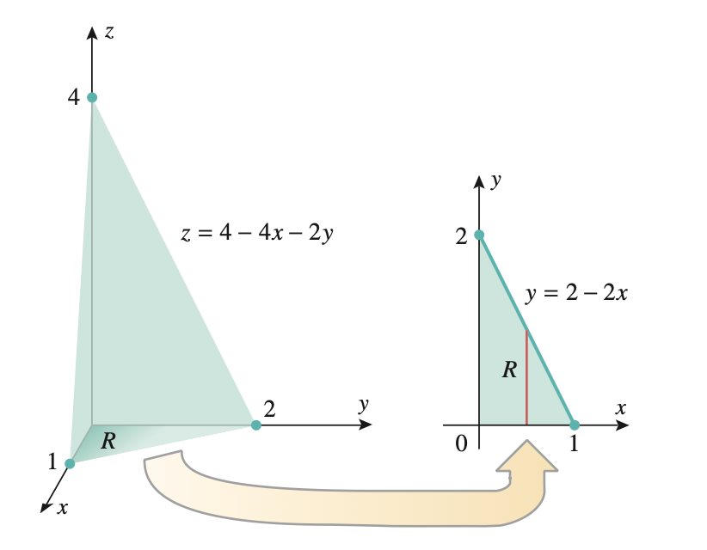
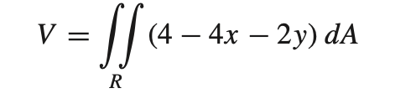
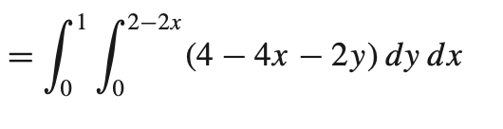
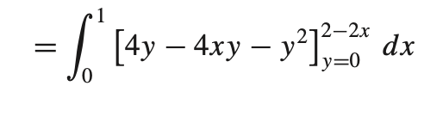
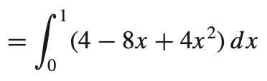


Slide 5
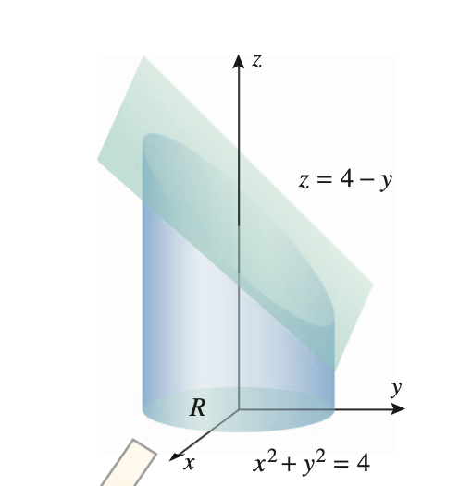
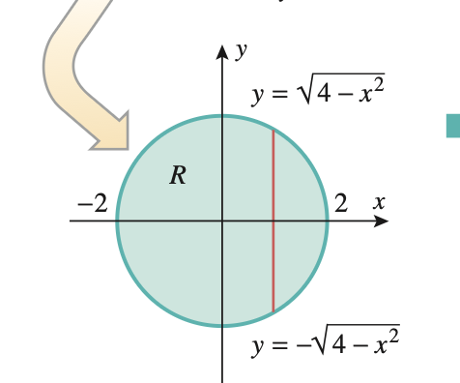
Find the volume of the solid bounded by the cylinder x² + y² = 4 and the planes y + z = 4 and z = 0.

Slide 6
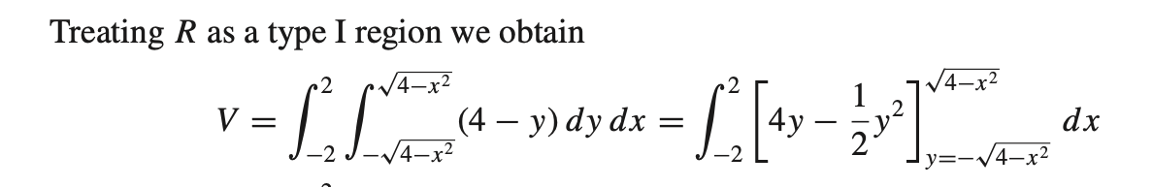
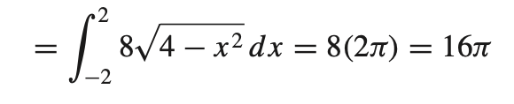

Slide 7
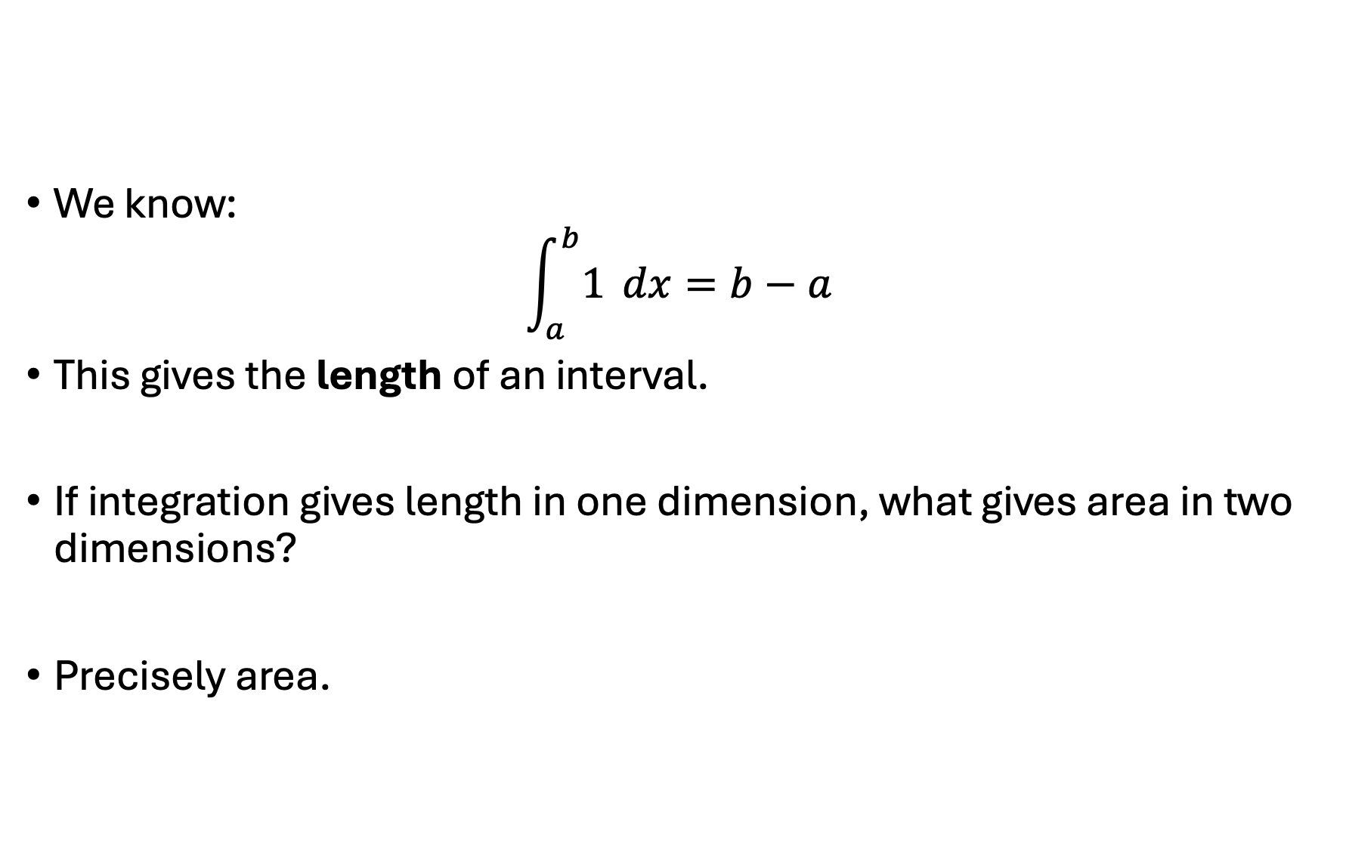
We know:
$$\int_{a}^{b}{1} dx=b−a$$
This gives the length of an interval.
If integration gives length in one dimension, what gives area in two dimensions?
Precisely area.

Slide 8
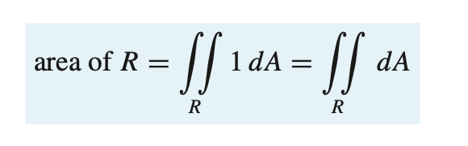
AREA CALCULATED AS A DOUBLE INTEGRAL
Although double integrals arose in the context of calculating volumes, they can also be used to calculate areas.
Now suppose that we are interested in finding the area A of a region R in the xy-plane.
If we translate the region R upward 1 unit, then the resulting solid will be with height 1 has cross-sectional area A, base R, and the plane z = 1 as its top.
Thus

Slide 9
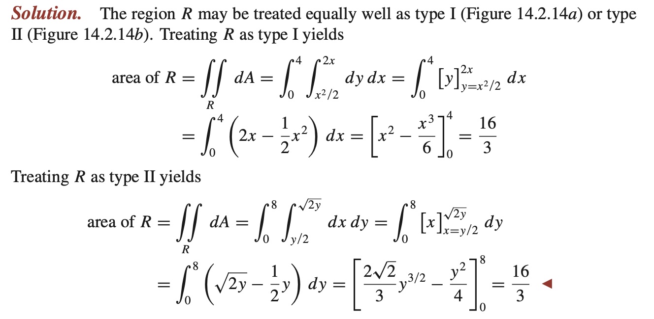
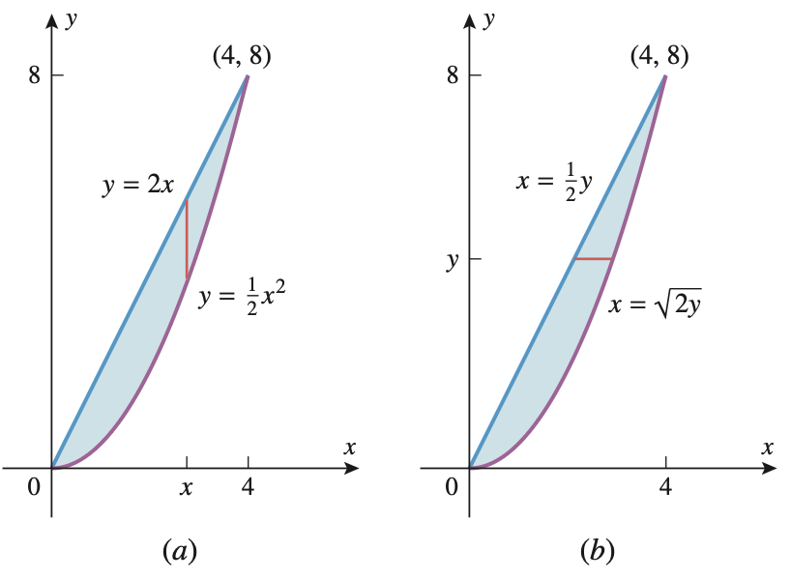
Use a double integral to find the area of the region R enclosed between the parabola y=0.5x² and the line y= 2x.

Slide 10
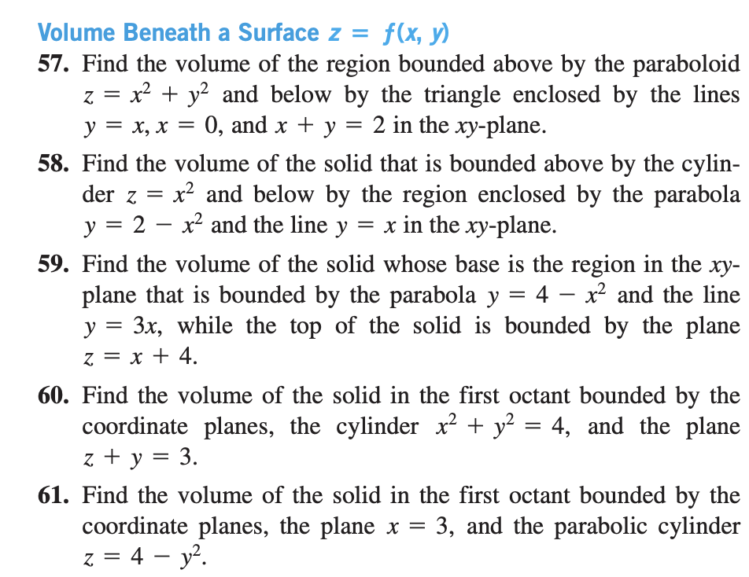

Slide 11
